Slide 1
Eye care at Nightingale

Slide 2
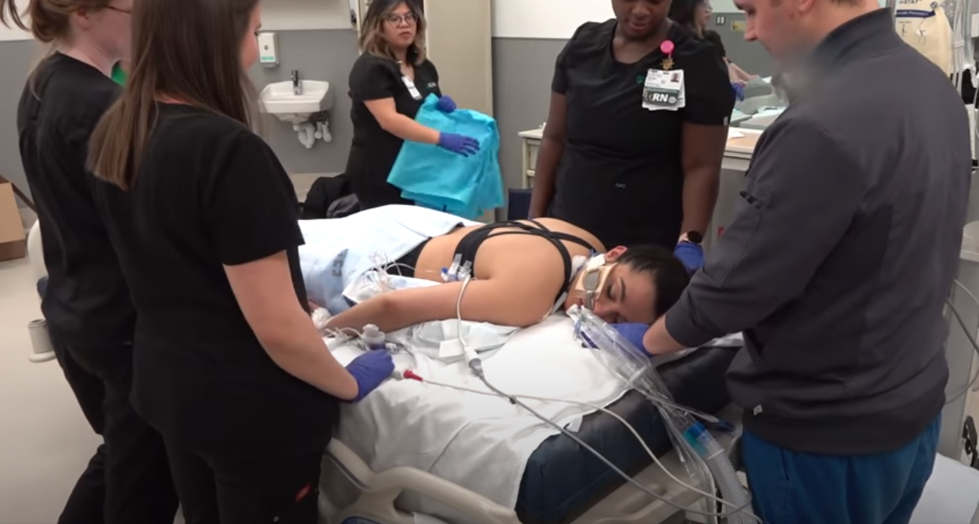


Slide 3
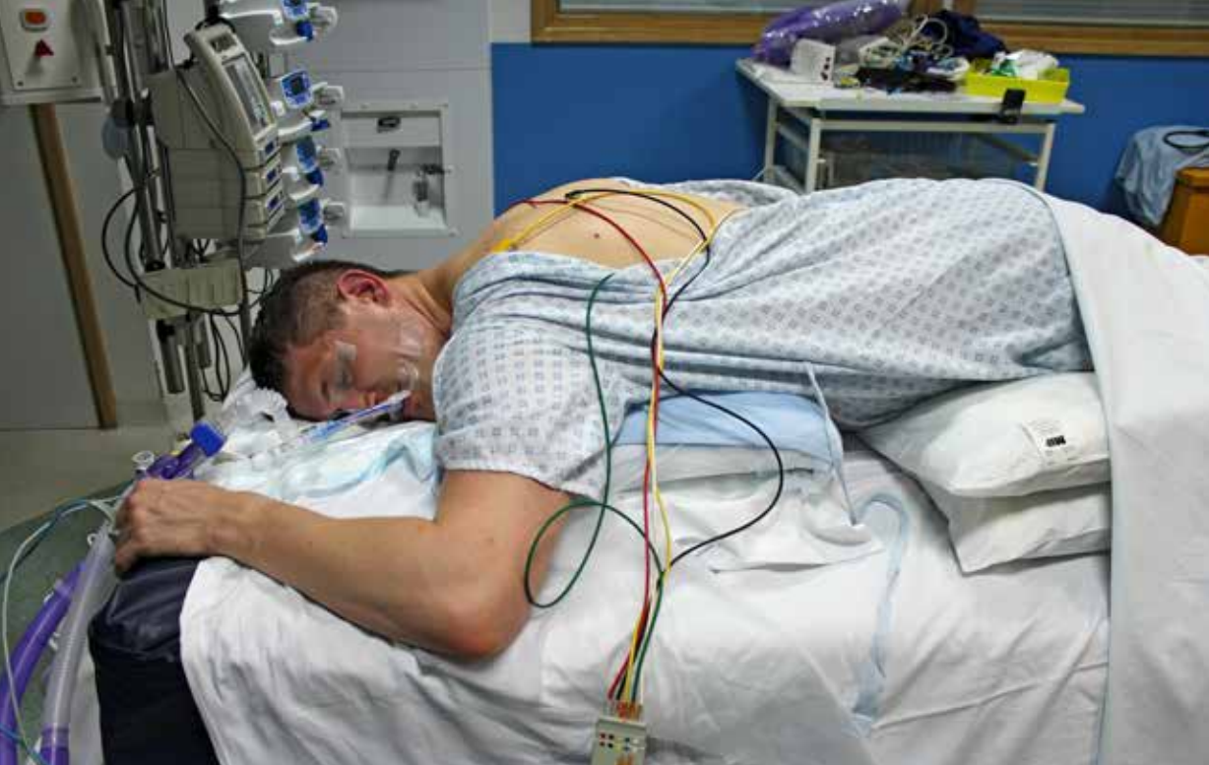
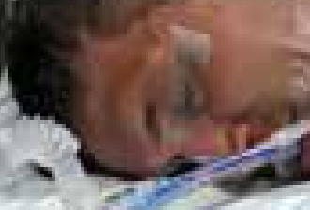

Slide 4
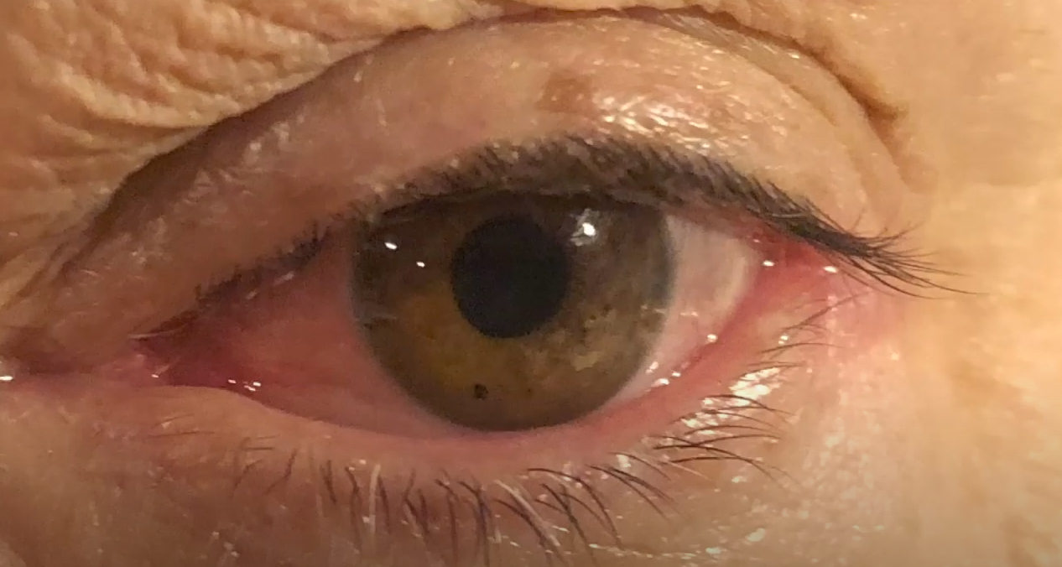
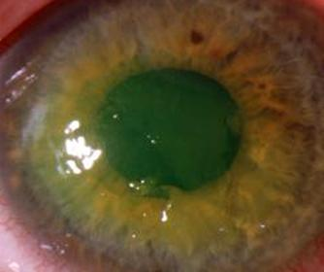

Slide 5
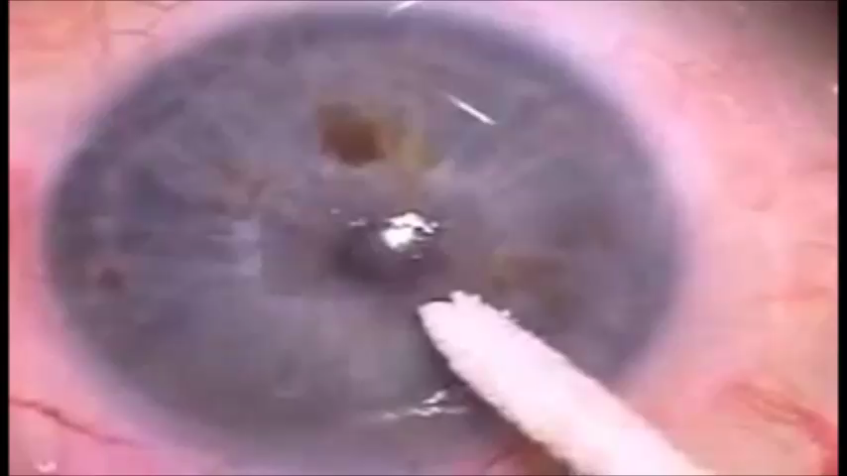

Slide 6
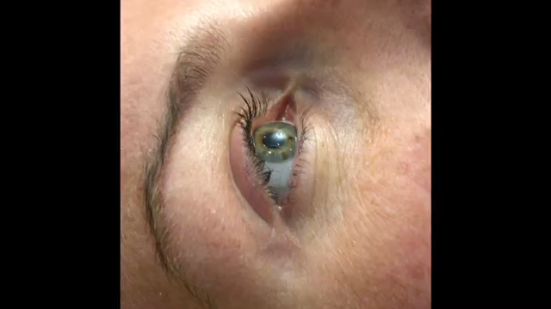

Slide 8
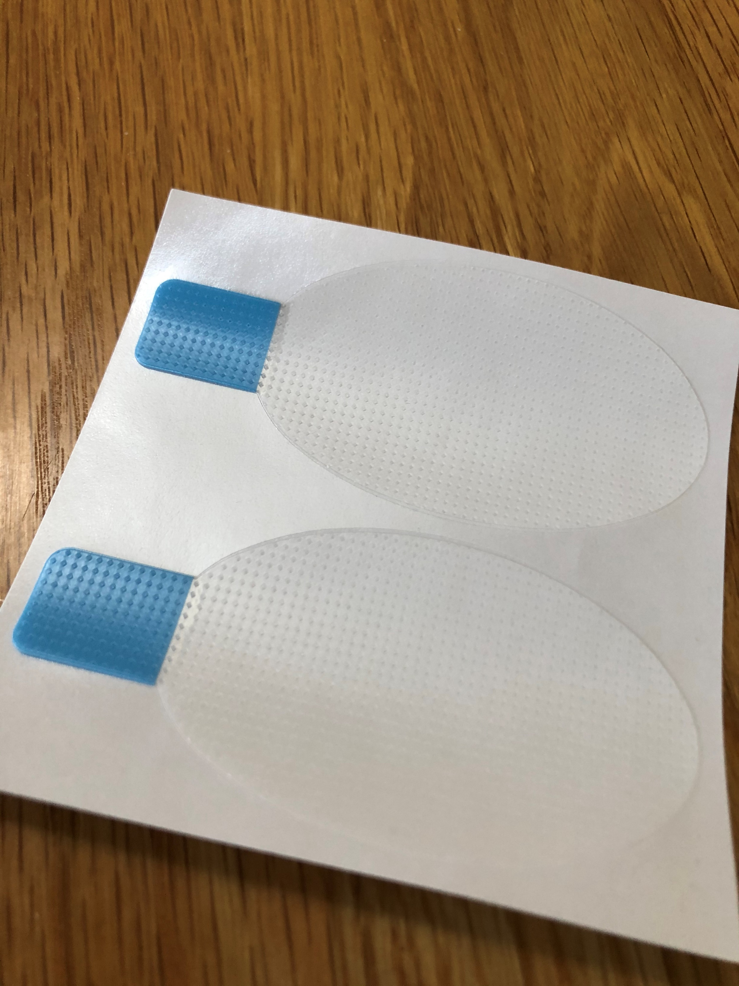

Slide 9
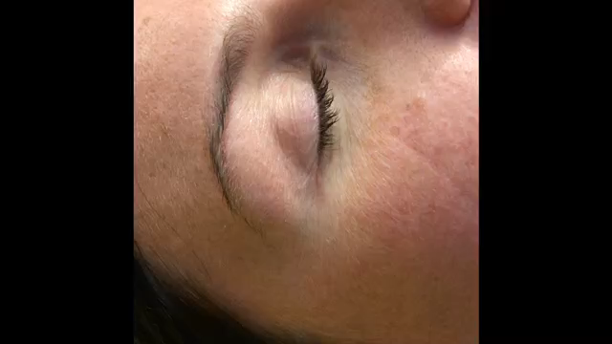

Slide 10
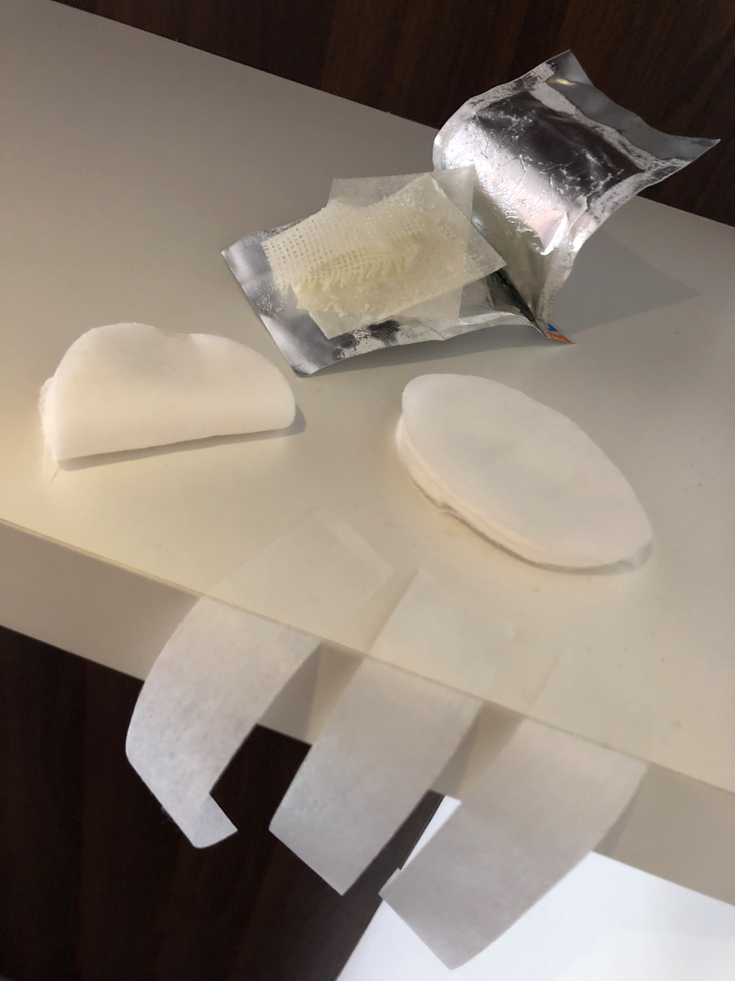
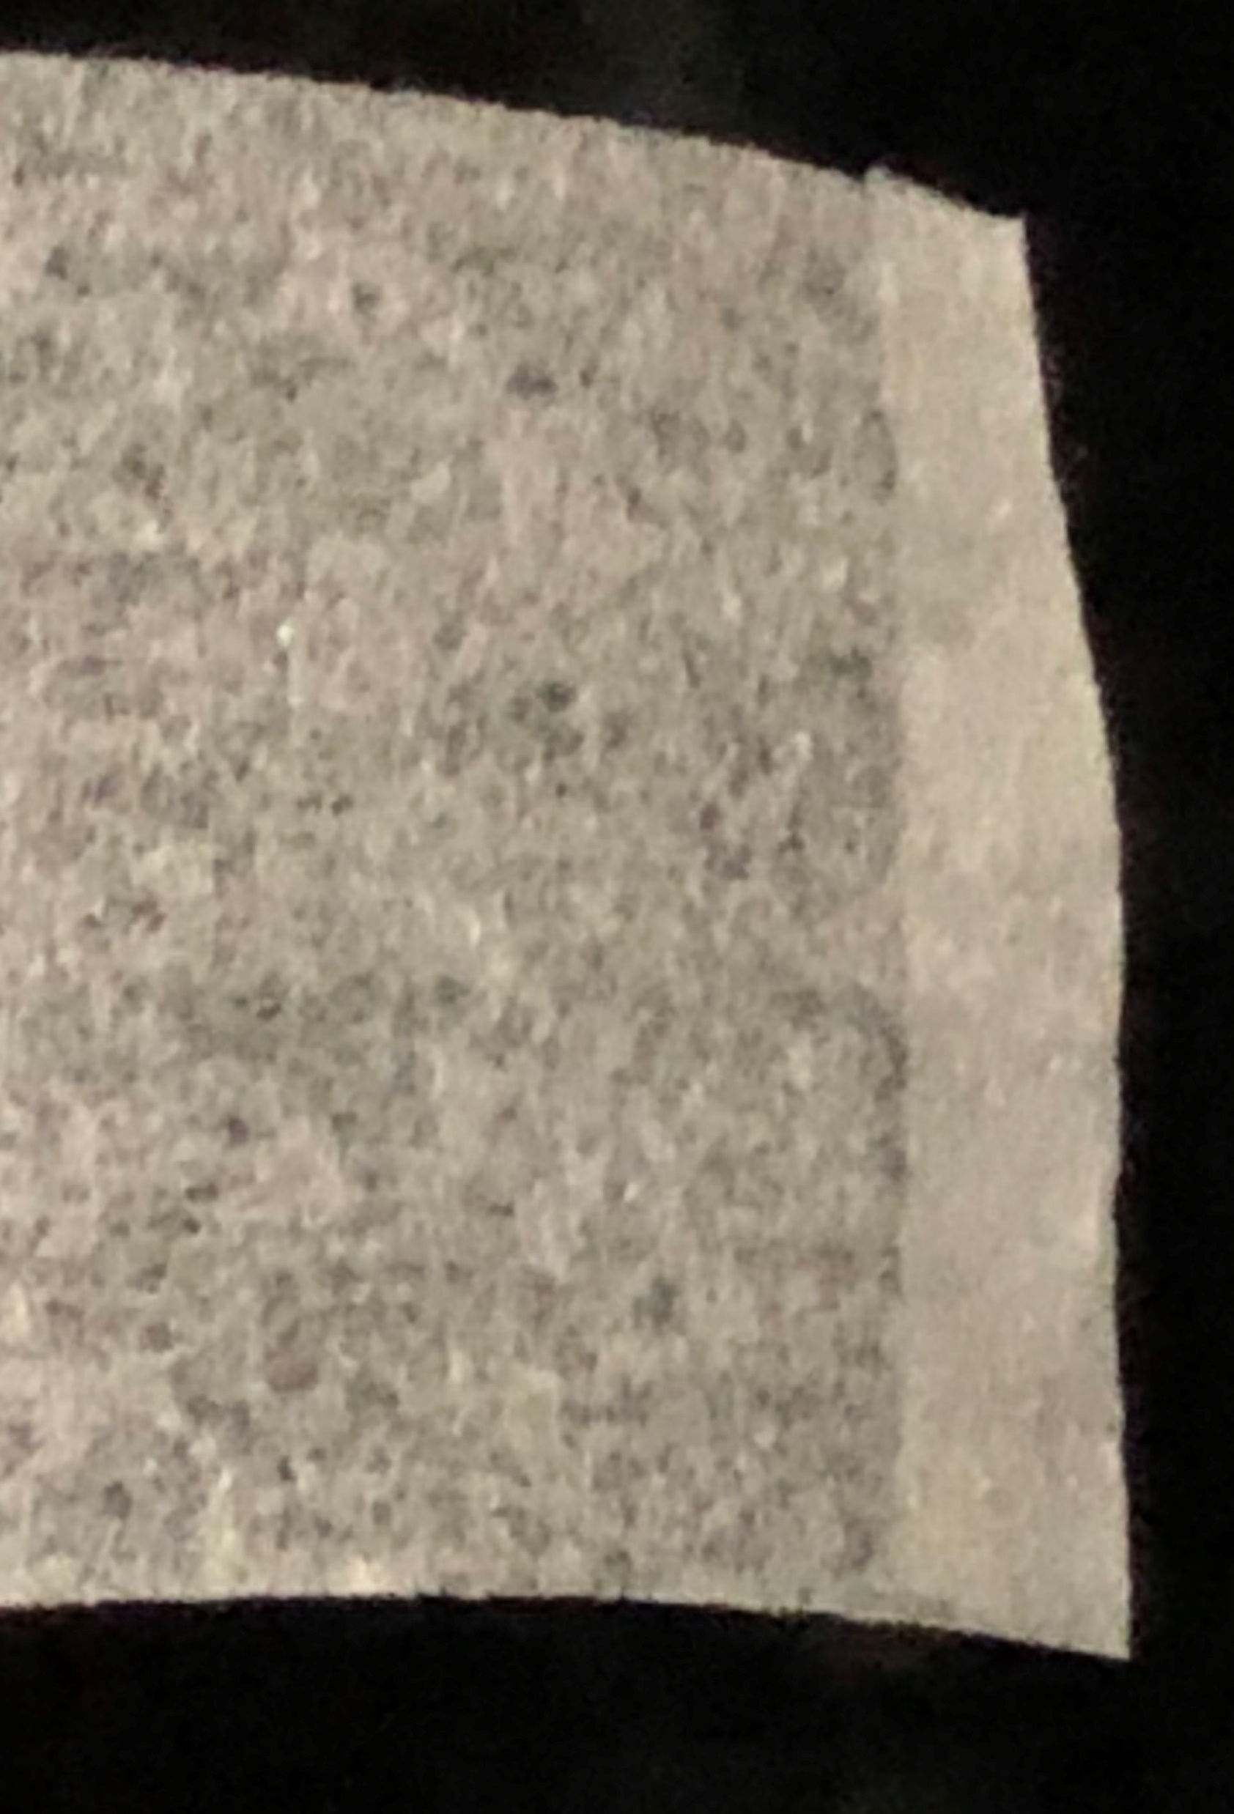

Slide 11
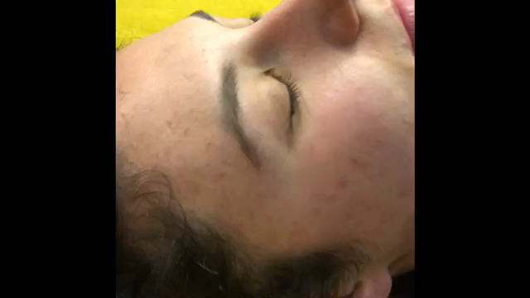

Slide 12
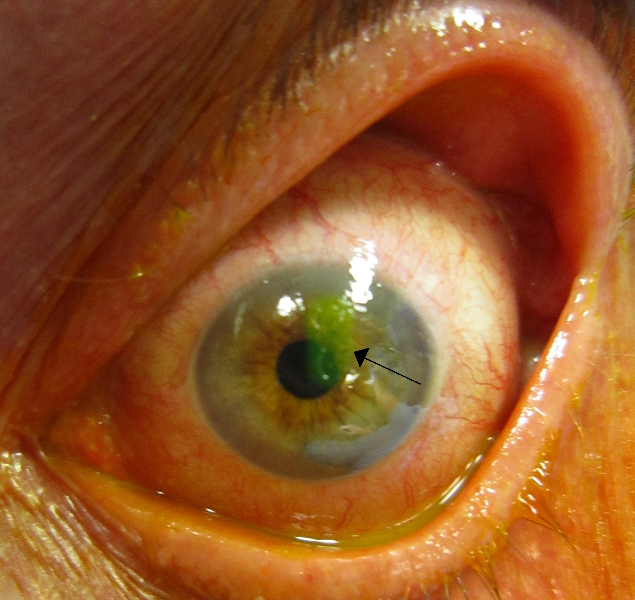
Problems
Corneal abrasion
SIGNS
Irregular corneal surface persistent after closing and opening lids
TREATMENT
Topical antibiotics and pad

Slide 13
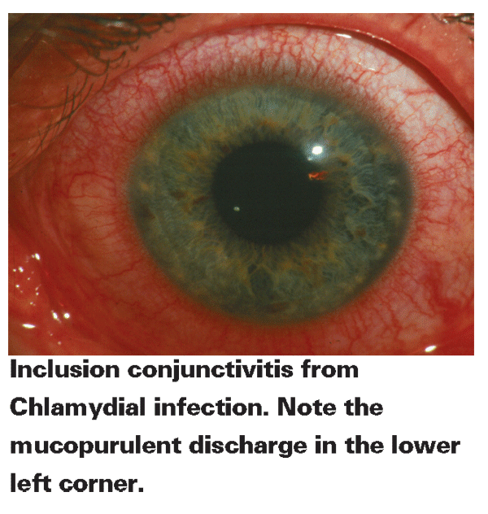
Problems
Corneal abrasion
Conjunctivitis
SIGNS
Red eye top and bottom (if just bottom more likely exposure). Bacterial sticky viral not sticky
TREATMENT
Topical antibiotics and care not to
transmit to others

Slide 14
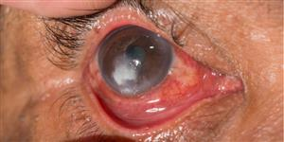
Problems
Corneal abrasion
Conjunctivitis
Corneal ulcer
SIGNS
Red eye
White spot/patch in cornea
TREATMENT
Intensive topical antibiotics and care not to transmit to others

Slide 15
If worried ask

